Slide 1

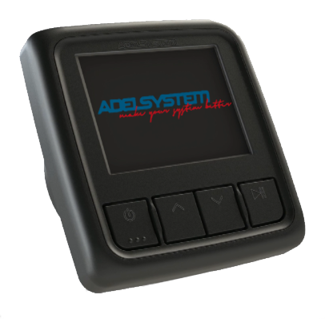
DPY351 Panel Controller

Slide 2
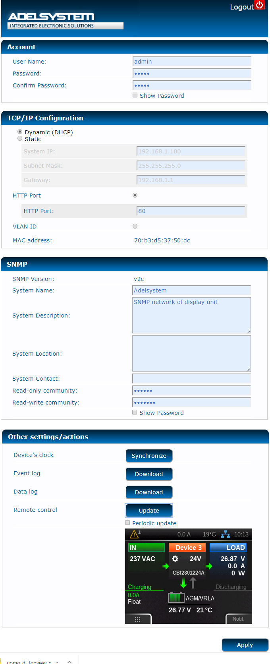
Web Server
You can access to the internal server and
manage everything remotely and change
Parameters.
Protocols:
CLOUD (MQTT)
SNMP
MODBUS TCP/IP
ADELVIEW SYSTEM

Slide 3
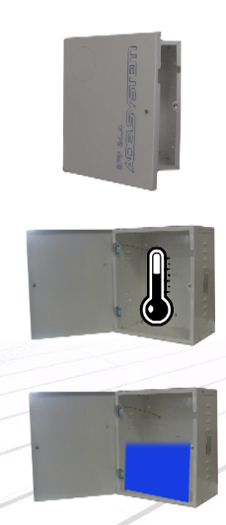

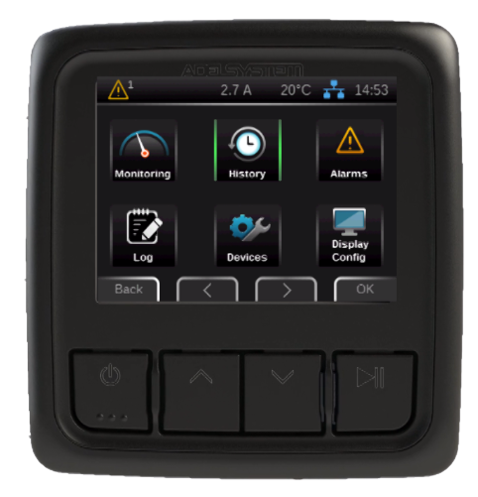
PLC Functions
Control with relay
Doors
Temperature
Water Level

Slide 4
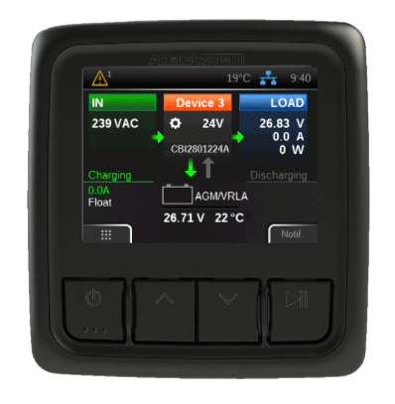
Dashboard
Alarm notification
Device data
Output data
Input data
Battery Status
Battery charge
status
Battery Voltage
Battery Temperature

Slide 5
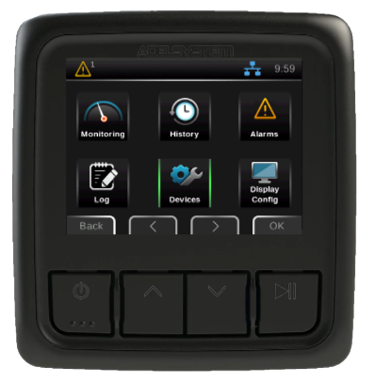
Welcome page
Data history
Alarms
notifications
Monitoring data
Data log
Display
configuration
Devices configuration

Slide 6
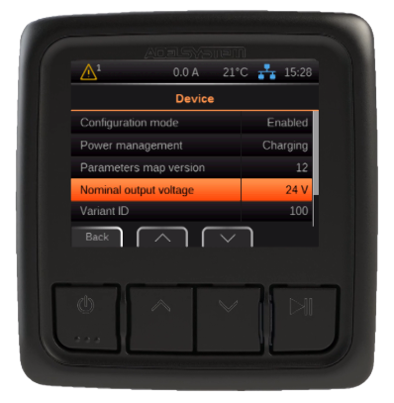
History
It reports:
number of charging
cycles, back-up numbers
maximum and minimum values during the
input and output.

Slide 7
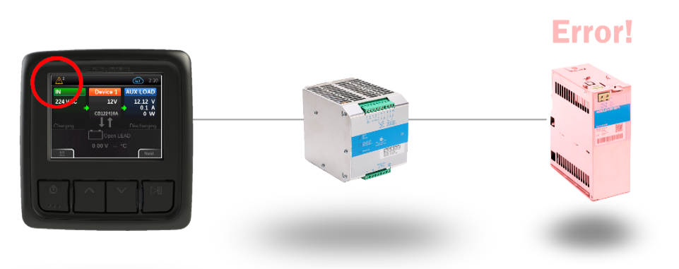
Alarms
Alarm notification

Slide 8
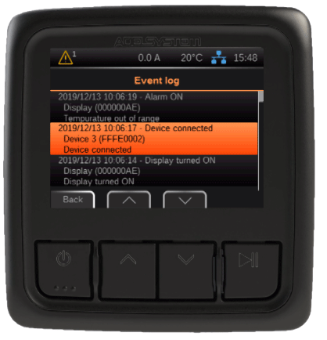
Log
The device displays the last
30 device events and every parameter of up to 10 days.

Slide 9
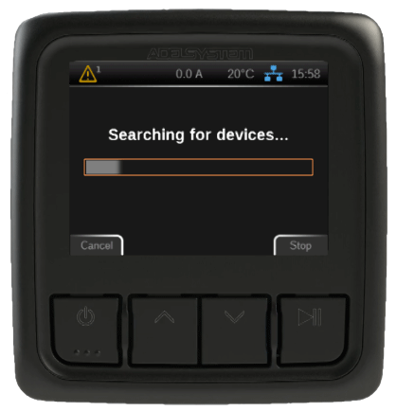
Devices
You can connect up to 30 devices.

Slide 10
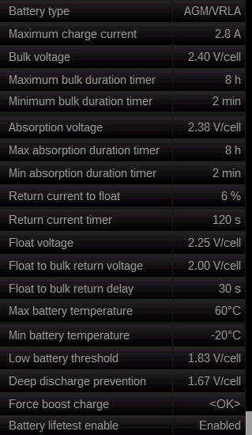
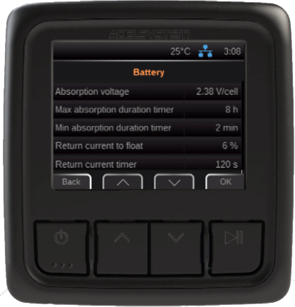
DEVICES: #1 advanced configuration
You can easily and quickly customize the most important parameters of the other connected devices.

Slide 11
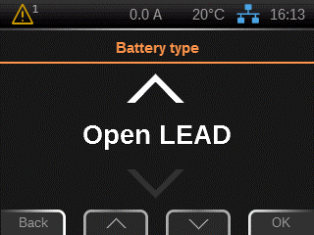
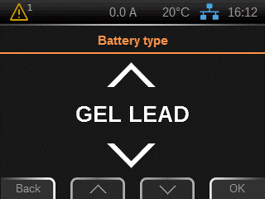
DEVICES: #1 advanced configuration
Battery type selection:
- Lead Acid
- Gel
- AGM
- Ni Cd
- Li-Ion
DEVICES: #1 advanced configuration

Slide 12
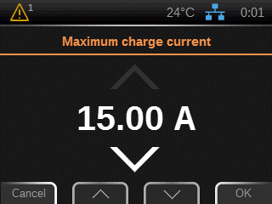
DEVICES: #1 advanced configuration
You can limit the
Charging Current.

Slide 13
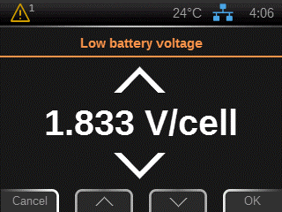
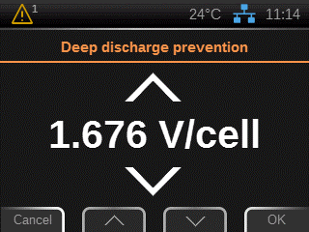
DEVICES: #1 advanced configuration
BULK, ABSORPTION, FLOAT
You can modify
- Voltage,
- Max time charging in any
stage of charge

Slide 14
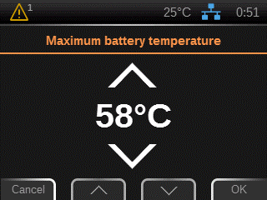
DEVICES: #1 advanced configuration
You can set min/max
temperature alarm
for Environment Area.
You can set temperature
compensation on the
Device: 60°> 20°

Slide 15
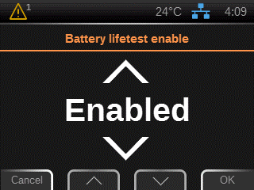

DEVICES: #1 advanced configuration
Threshold alarm Battery
almost flat.
Set protection
against total discharge.

Slide 16
DEVICES: #1 advanced configuration
Fast Charging and
Lifetest Battery can be enabled

Slide 17
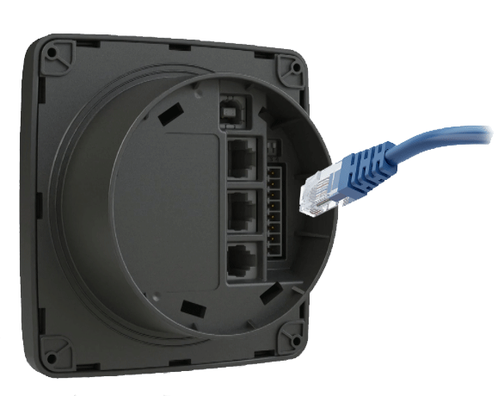
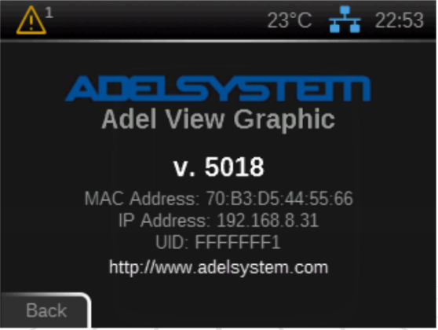
1)
DEVICES: #1 advanced configuration
Drive internal Web Server for
remote control.
Main important parameters
can be modified.
2)

Slide 18
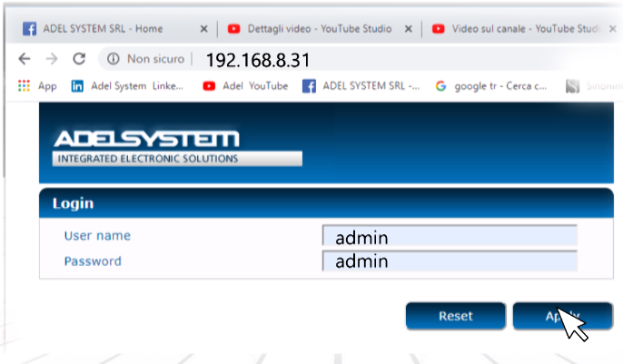
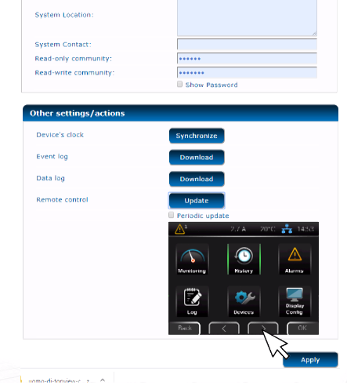
3)
DEVICES: #1 advanced configuration
4)

Slide 19
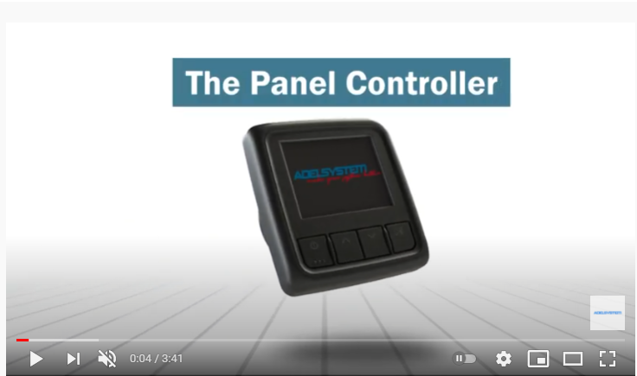
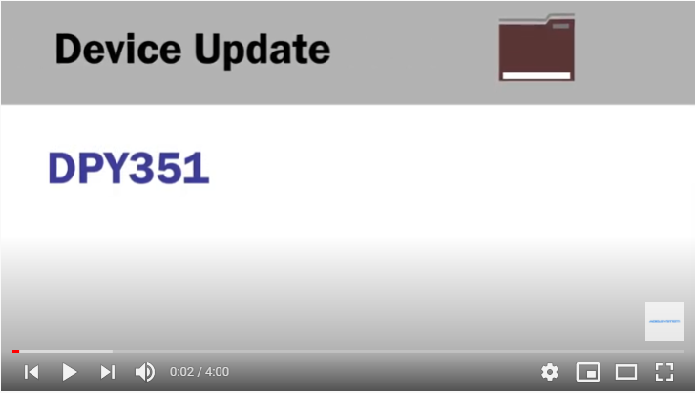
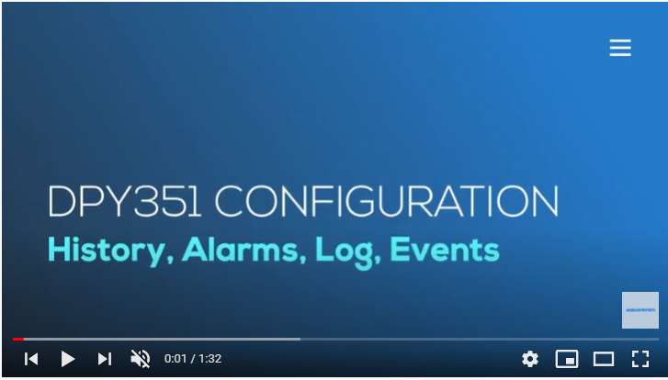
Video

Slide 20





www.adelsystem.com
info@adelsystem.com
Via Luigi Barchi 9/b, 42124 Reggio nell'Emilia
Telephone: +39 0522-345518

